Slide 1
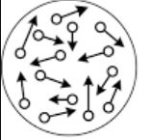
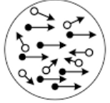
Investigating Accuracy and Bias using estimation errors in a Human Perceptual Decision-Making Task
Project by: Amin Khatami, Anushree Ganesh, Xima Ran and Xinran Liu
Notes:
Amin

Slide 2
Introduction
This dataset interested us since it was derived from a human perceptual decision making task.
We were interested in understanding the biases that play a role in the decision making processes.
To this end, we used reaction times and estimation errors across the different prior distribution standard deviations in order to map out if prior STD affects the performance.
Notes:
Amin

Slide 3
Methods
We are using regression models to investigate the dynamics of learning and decision-making across different stimulus strengths and prior distributions (PD) variance in a perceptual decision-making task.
We conducted Bartlett’s test for homoscedasticity and Kruskal-Wallis test for the difference between sets
Notes:
Amin

Slide 4
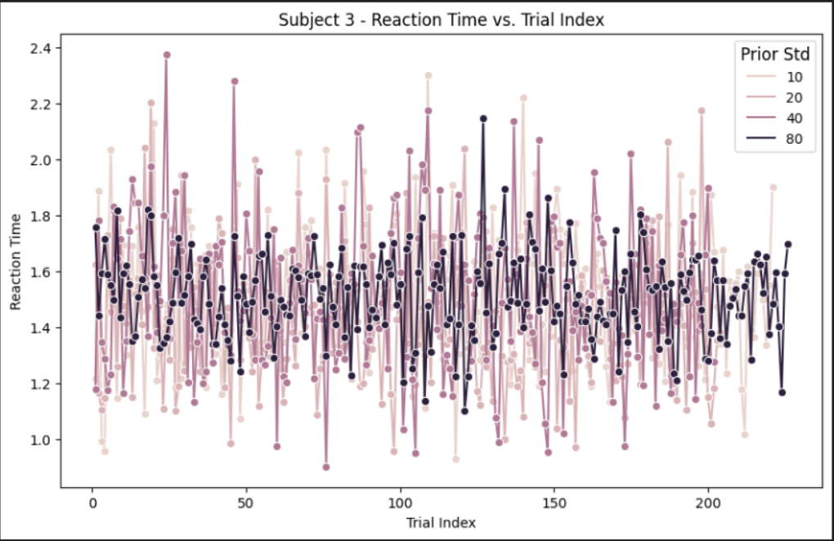
Results: reaction time dynamics
We selected 4 subjects and plotted the averaged reaction time ~ trial index graphs. Different colors represent different prior standard deviations.
Notes:
Jess

Slide 5
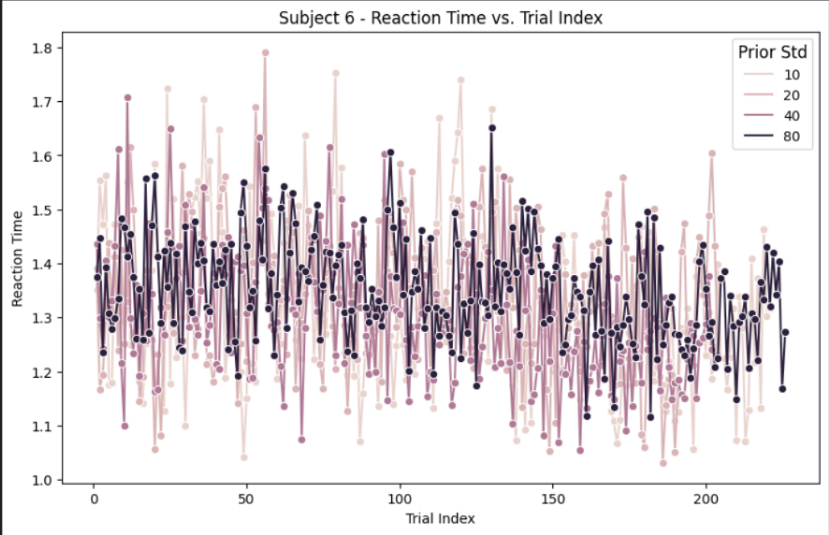
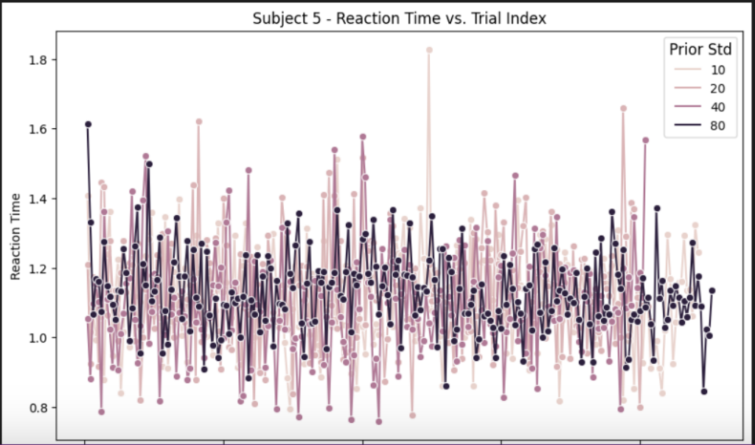
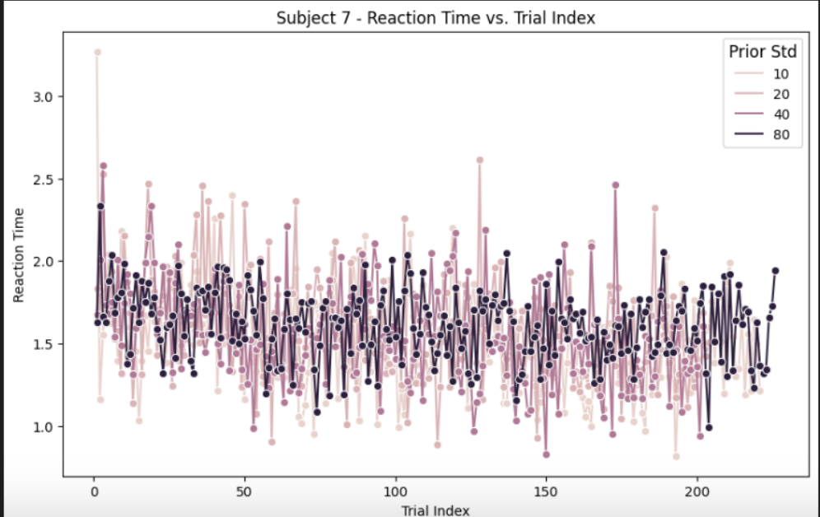
Notes:
eyeball -> degree of fluctuation of reaction time
Bartlett's test to see whether the variance of reaction time among std groups are significantly different
p = .001=> std has effect on reaction time

Slide 6
Conclusion - Reaction time dynamics
The prior std group 80 has faster reaction times compared to the other three prior standard deviations.
This is incongruent with our expectations. We thought that prior std 10 would have faster reaction times than the other three.
This might be due to prior std of 10 has greater motion coherence compared to prior std of 80.
Bias may play a bigger role in prior std 80, but this will need to be evaluated through further research.

Slide 7
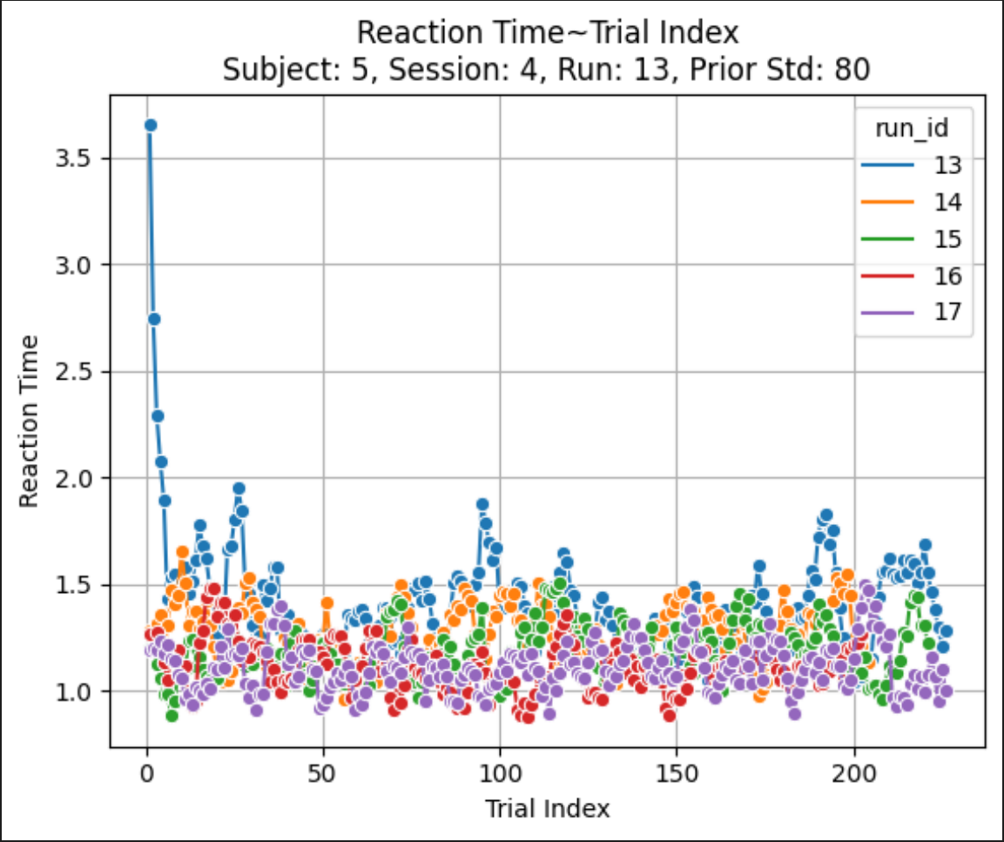
Results: Learning effects
We plotted all the runs for one subject with a particular prior standard deviation in order to check for learning over different trials.
Notes:
Xima

Slide 8
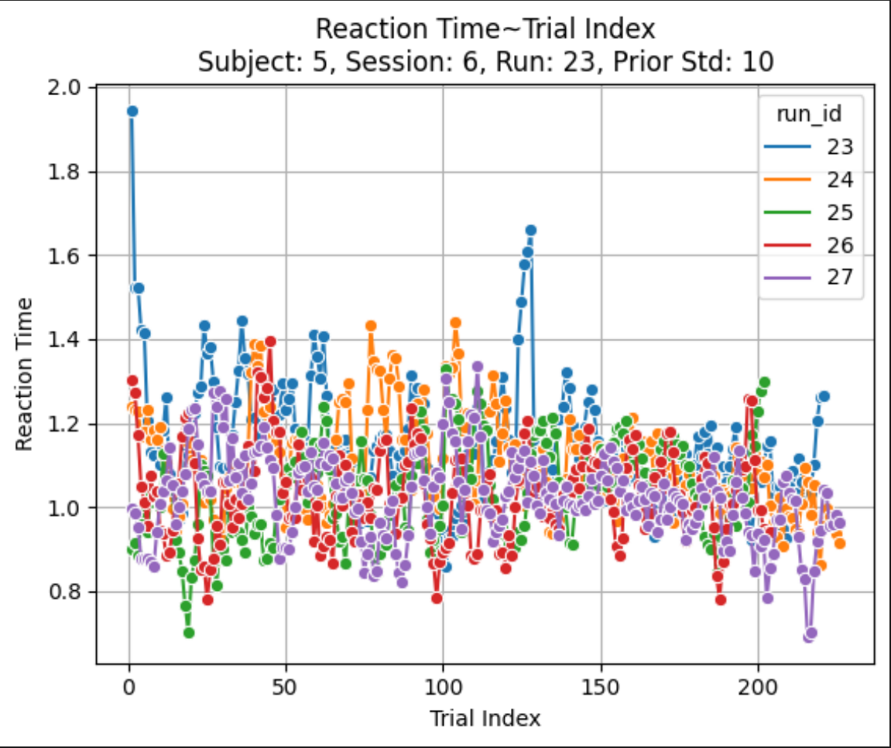
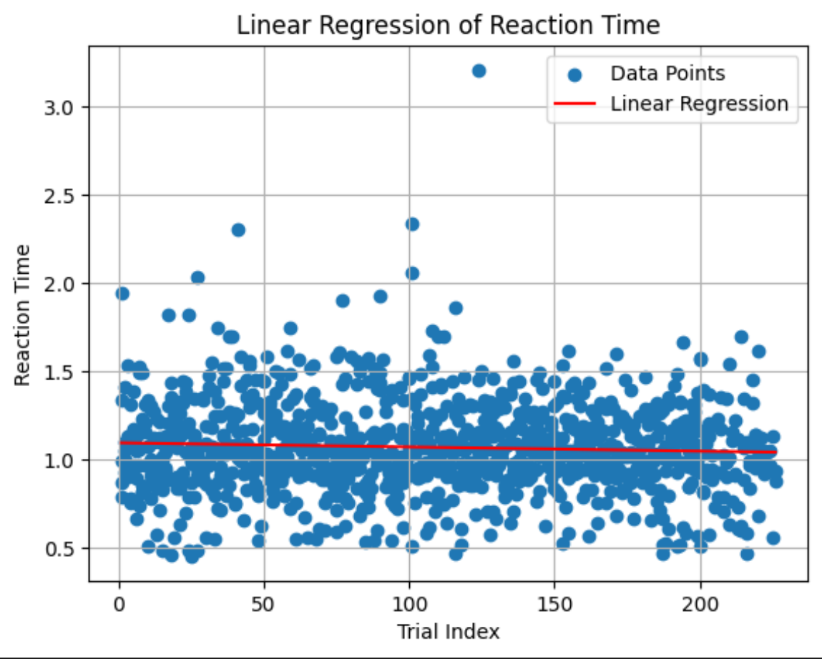
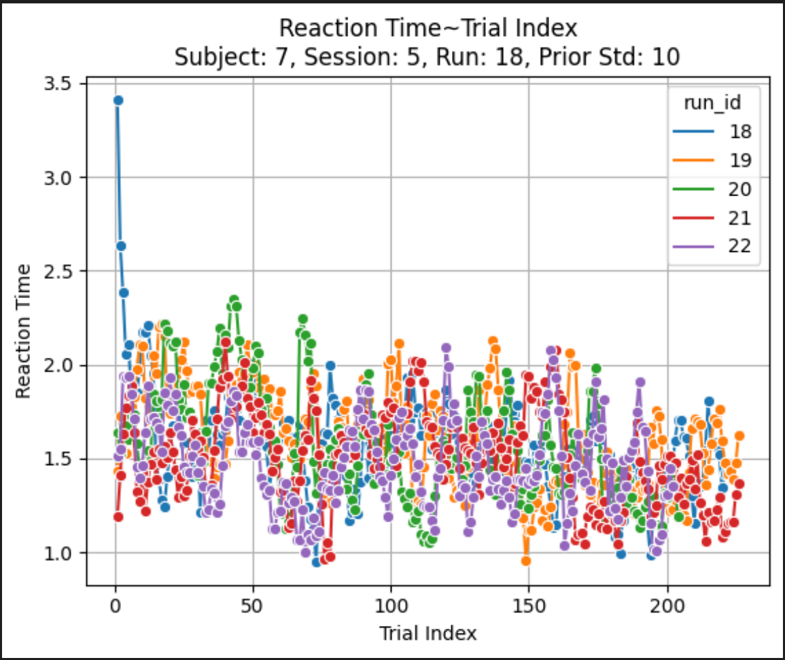
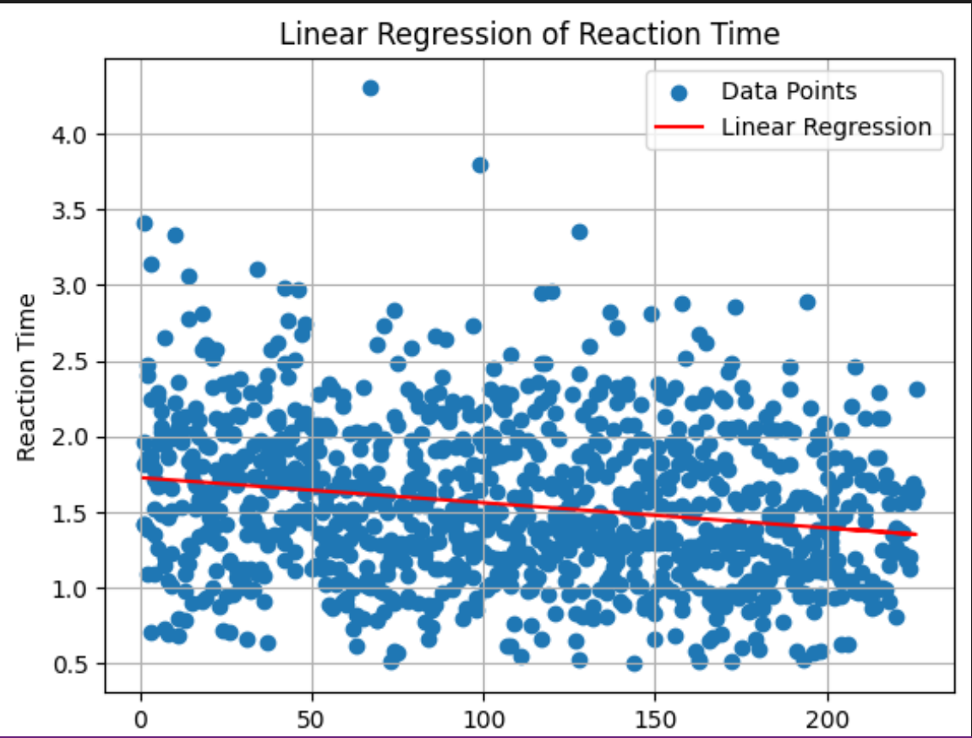
Intercept: 1.094004924429369
Coefficient: [-0.00023527]
R-squared: 0.0031963738008041753
Intercept: 1.7266175196335807
Coefficient: [-0.00166063]
R-squared: 0.03982000993687729

Slide 9
Conclusion - Learning effects
Reaction time of the first few trials in the first run was the longest.
Reaction time becomes faster as runs progresses
Finally, reaction stablizes around a straight line.
Average reaction time can show individual differences
There seems to be a positive learning effect, but further evaluation over a longer timescale will be needed to ascertain.
R-squared value is small, suggesting linear regression may not be a good model, other models should be considered for future analysis.

Slide 10
Future Directions
Learning effects can be evaluated by plotting the trends over all the subjects and all the trials.
Some other models such as Drift-Diffusion Model and Long-range temporal correlation models could be applied.
Checks can be made specifically for biases, like the cardinal bias or waterfall aftereffect illusion.
We also think that the experiment procedure can lead to some bias as well since the response wheel is preset to a random position and has to be rotated in order to get the response which could affect the response time.
Notes:
Anu

Slide 11


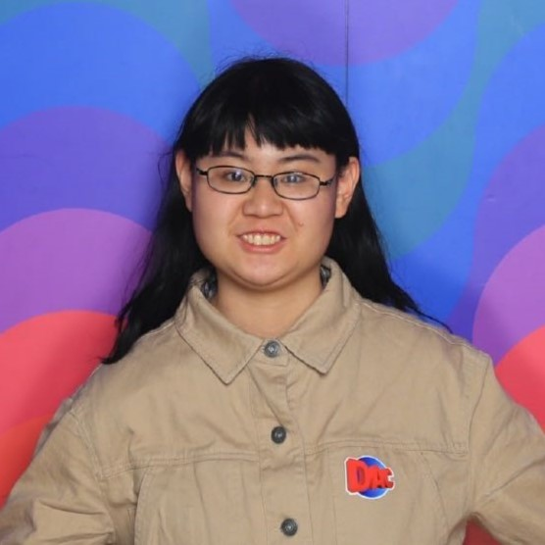

Group: Believers Pod: haplocheirus_shout
Group Members: Amin Khatami, Anushree Ganesh, Xima Ran, Xinran Liu
Mentor: Dr. Maria Nazarova
Regular TA: Harsh Arora
Project TA: Weina (Helena) Chen

Slide 12
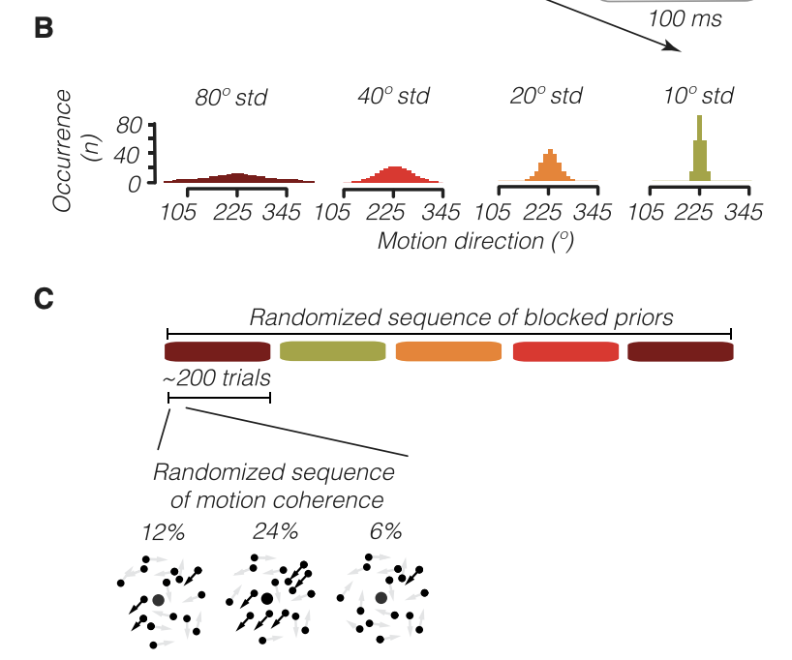
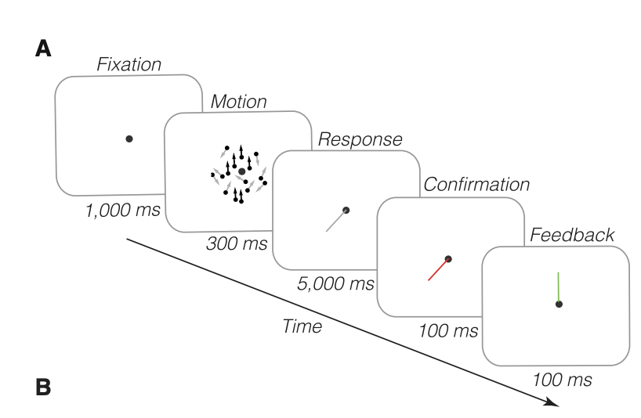
Additional Figures: Trial design - Block design

Slide 13
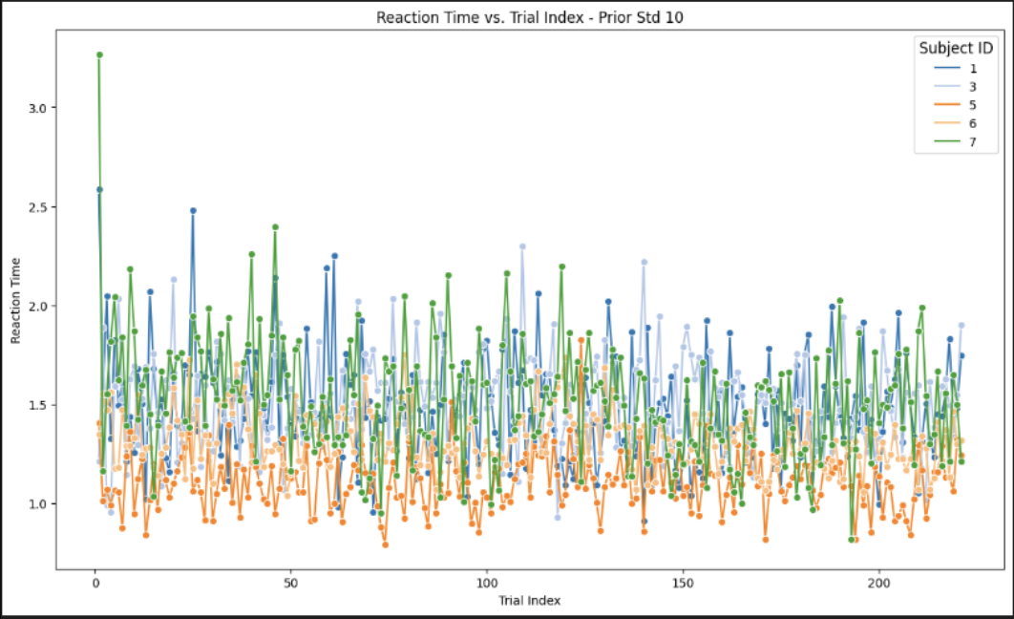
Additional Figures: Reaction Time-Trial Index for each STD prior
Color code represents different subjects. 4 subplots are 4 different standard deviation levels.

Slide 14
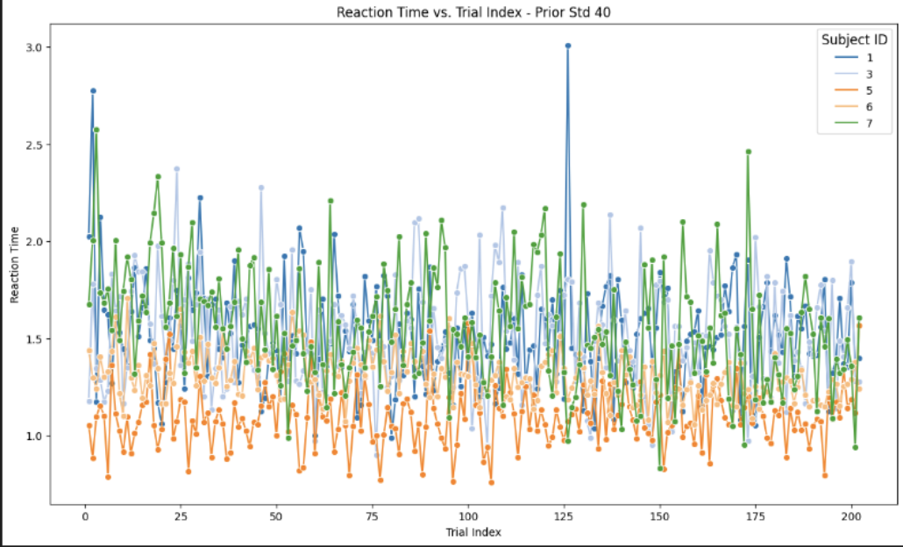
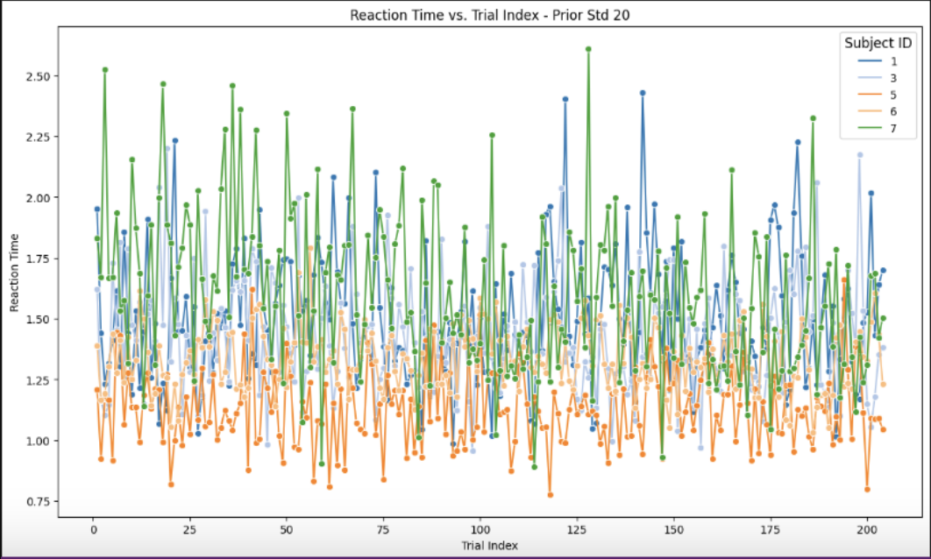
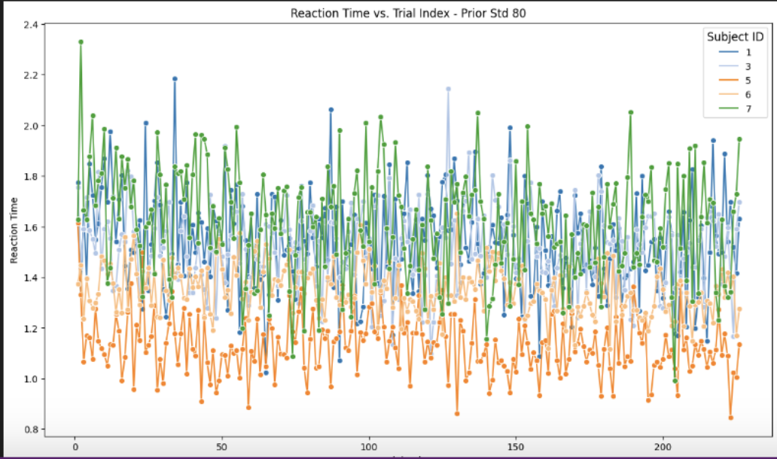

Slide 15
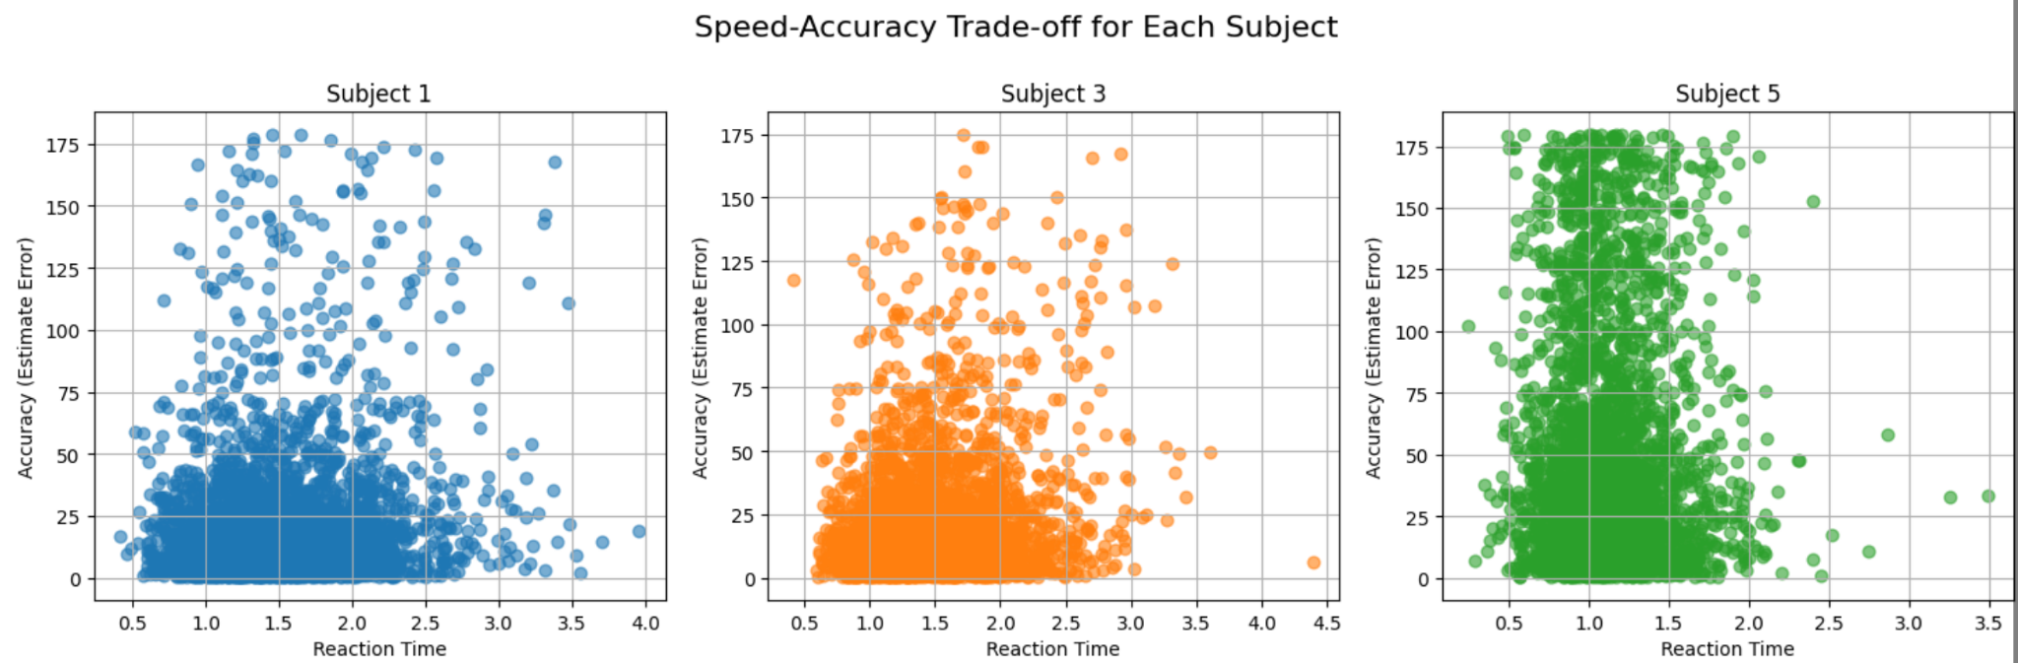
Results: Speed-Accuracy Trade-off

Slide 16
